Slide 1

K. J. Somaiya Institute of Information Technology, Mumbai
Department of Electronics and Telecommunication Engineering
Project Competition
PRAGYAN 2.0 under ABHIGYAN 2026
on
8th October 2026
Academic Year 2025-2026
Design and Implementation of a LoRa-Based Real-Time Tracking and Communication System
Sujal Bhandari (LYB-26) | Varsha Chaudhari (LYB-27) | Pratik Narvadkar (LYB-54)
Guide: Prof. Rupali Satpute
Notes:
Presentation based on the current LoRaTrack project progress and the supplied Somaiya PRAGYAN 2.0 format.

Slide 2
Presentation Outline
Abstract and project introduction
Project statement, objectives and literature survey
Relevance and system design
Block diagram, hardware/software and circuit
Implementation, results and discussion
Conclusion, future scope, applications and references
2

Slide 3
Abstract
This project develops a two-way outdoor location-sharing system using smartphone GPS, an Android application, Bluetooth Low Energy, ESP32 boards and SX1278 LoRa transceivers.
The phone sends its coordinates to the nearby ESP32 over BLE. LoRa carries the location packet to the second node, which forwards it to the other phone. The core device-to-device path operates without cellular data or internet.
3

Slide 4
Introduction
Outdoor groups may need to share their positions where mobile coverage is weak or unavailable.
Smartphone GPS provides coordinates, while the custom app presents each user’s location and communication status.
BLE links each phone to its ESP32 node. LoRa transfers location packets between the two nodes.
The design supports users such as trekkers, field teams and remote-area groups.
4

Slide 5
Proposed Project / Model / Idea Statement
A portable, two-user tracking and communication prototype that relays smartphone location data between two ESP32 devices over a direct LoRa radio link, then displays received information in a paired Android application.
Each side uses the same node design. The phones provide GPS coordinates and a user interface; BLE carries data locally between phone and ESP32; SX1278 LoRa modules carry packets between users. The LoRa link does not require a cellular network or internet connection.
5

Slide 6
Objectives
Share live smartphone GPS coordinates between two users.
Connect the Android application to each ESP32 node over BLE.
Transmit and receive location packets through SX1278 LoRa modules.
Display the other user’s received location in the application.
Assess packet reception and signal quality using RSSI and SNR readings.
6

Slide 7
Literature Survey
Study and focus
Relevance to this project
R. Kumar et al. (2020), “LoRa Based GPS Tracking System” (IJIRSET)
Methods: LoRa communication and GPS. Application: asset tracking.
A. Verma and P. Singh (2021), “Child Tracking System using IoT & LoRa” (IEEE Conf.)
Methods: IoT, GPS and LoRa. Application: child safety.
Long-range tracking using LoRa + GPS. Limitation: limited accuracy in dense urban areas.
Real-time child-location monitoring using LoRa. Limitation: transmission delay over long distances.
S. Gupta et al. (2022), “Smart Wearable Tracking Device” (IJERT)
Methods: embedded systems and GPS. Application: wearable safety devices.
M. Ali and K. Khan (2023), “LoRa-based Smart Monitoring System” (Springer)
Methods: LoRa and cloud IoT (MQTT). Application: smart cities and tracking.
Wearable device for human tracking using sensors. Limitation: high power consumption.
LoRa integrated with a cloud dashboard for monitoring. Limitation: requires internet/cloud setup.
7
Notes:
Sources: Hashim et al., “Location tracking using LoRa,” IJECE, 2021, DOI 10.11591/ijece.v11i4.pp3123-3128. https://doi.org/10.11591/ijece.v11i4.pp3123-3128
Muladi et al., “LoRa Mesh-Based IoT GPS Tracking System for Mountain Climbers,” IJSSE, 2024. https://doi.org/10.18280/ijsse.140610

Slide 8
Social / Medical / Agricultural / Industry Relevance
The prototype is designed for general outdoor and remote-area use.
Social safety: lets members of an outdoor group exchange their locations.
Emergency response: can support location sharing when cellular coverage is limited, subject to radio-link availability.
Agriculture and field work: the same node architecture could be adapted for staff or asset location across remote sites.
Industrial operations: a low-rate radio link can support position updates for teams working across large areas.
8

Slide 9
Block Diagram and Its Explanation
Current bidirectional data path
BLE
BLE
Phone 1
GPS + app
ESP32 1
BLE node
SX1278
LoRa 433 MHz
SX1278
LoRa 433 MHz
ESP32 2
BLE node
Phone 2
GPS + app
Phone 1 sends GPS coordinates through BLE to ESP32 1. The LoRa link carries the packet to ESP32 2, which forwards it by BLE to Phone 2. The same path works in reverse.
The core LoRa exchange works without internet or cellular service. Phones still need GPS reception to determine their coordinates.
9
Notes:
System diagram reflects the current app-based design: smartphone GPS and Android app connected to ESP32 over BLE, with two SX1278 LoRa radios between nodes.

Slide 10
Software and Hardware Requirements
Hardware
Software
2 × ESP32 development boards
Android app built with Flutter
2 × SX1278 / LoRa-02 433 MHz transceivers with antennas
ESP32 firmware developed in Arduino IDE
2 × Android smartphones with GPS and BLE
BLE for phone-to-node data exchange
USB or suitable regulated power for each node
LoRa packet exchange; RSSI/SNR viewed during serial testing
Use the supply voltage and antenna connection specified for each board/module.
10

Slide 11
Circuit Diagram and Its Explanation
ESP32 ↔ SX1278 connection (repeat for both nodes)
ESP32
SPI + control pins
SX1278 LoRa module
433 MHz
SPI / control wiring used in the firmware
SCK GPIO 14 | MISO GPIO 12 | MOSI GPIO 13
CS GPIO 15 | RESET GPIO 27 | DIO0 GPIO 26
Power and ground must match the specific module board.
The phone communicates with ESP32 over BLE, so no wired phone connection is required.
11

Slide 12
Project Implementation with Steps and Flow Diagram
Read phone GPS
Send over BLE
ESP32 builds packet
LoRa transmits
Peer forwards to app
1 Pair each phone with its ESP32 over BLE.
2 Read latitude, longitude and location fields from smartphone GPS.
3 Send a location packet over LoRa, receive it on the other node, then update the paired app.
4 Repeat in both directions and inspect received packets plus RSSI/SNR during testing.
12

Slide 13
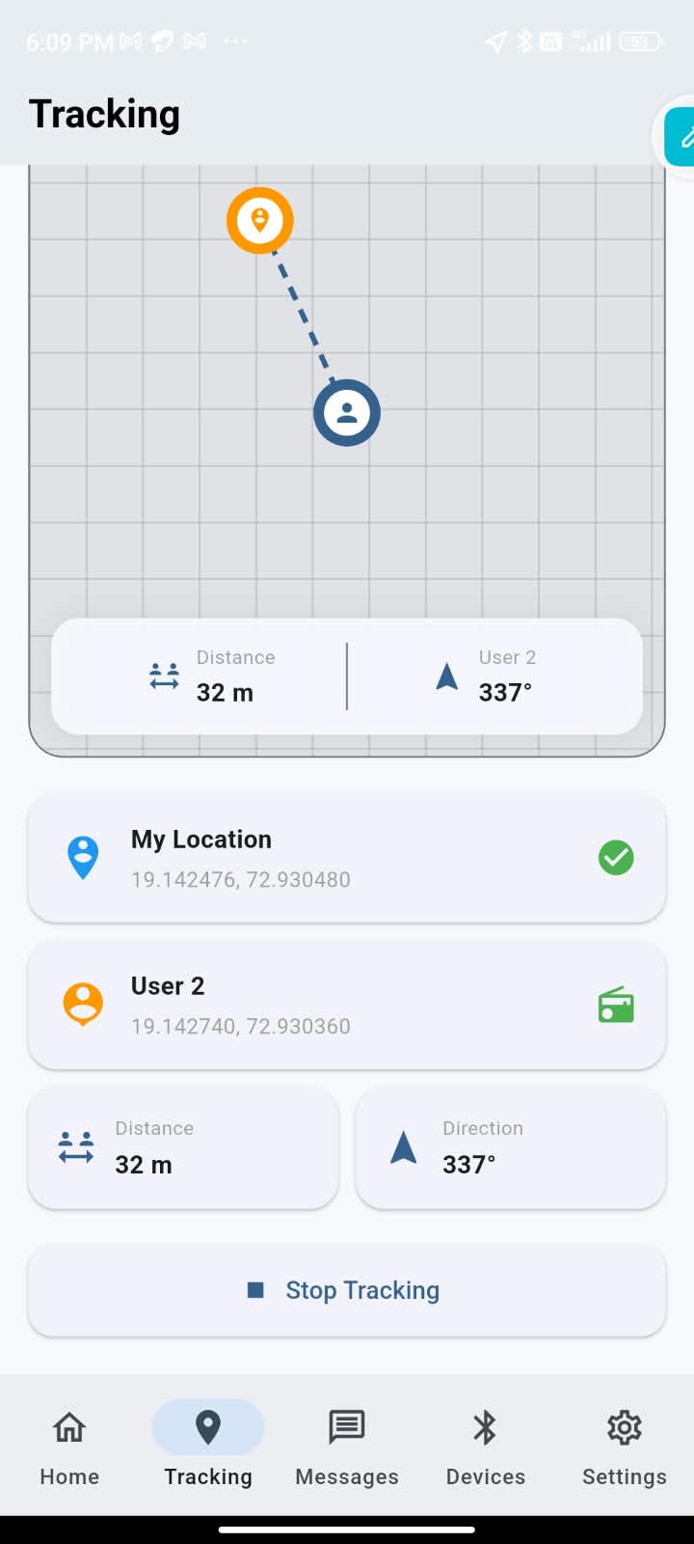
System Design Idea and Current Progress
Current app and data flow
Phone GPS supplies latitude, longitude, accuracy, altitude and speed.
Bluetooth/BLE links the app with the ESP32 node.
LoRa carries location messages directly between the two ESP32 nodes.
The receiving node sends the other user’s data to the second phone.
The app includes Home, Tracking, Messages, Devices and Settings screens, with local storage and dark/light mode.
18

Slide 14
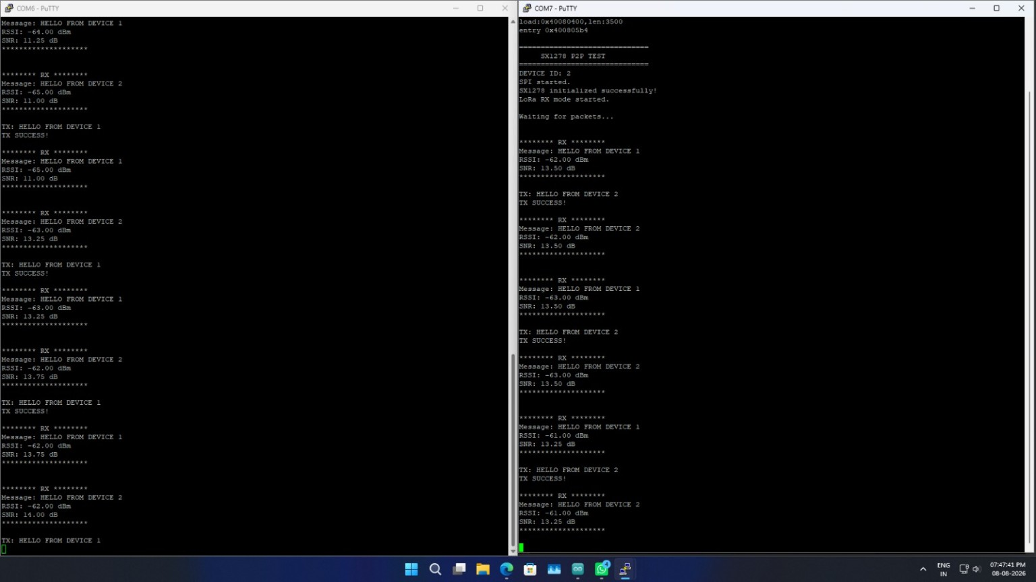
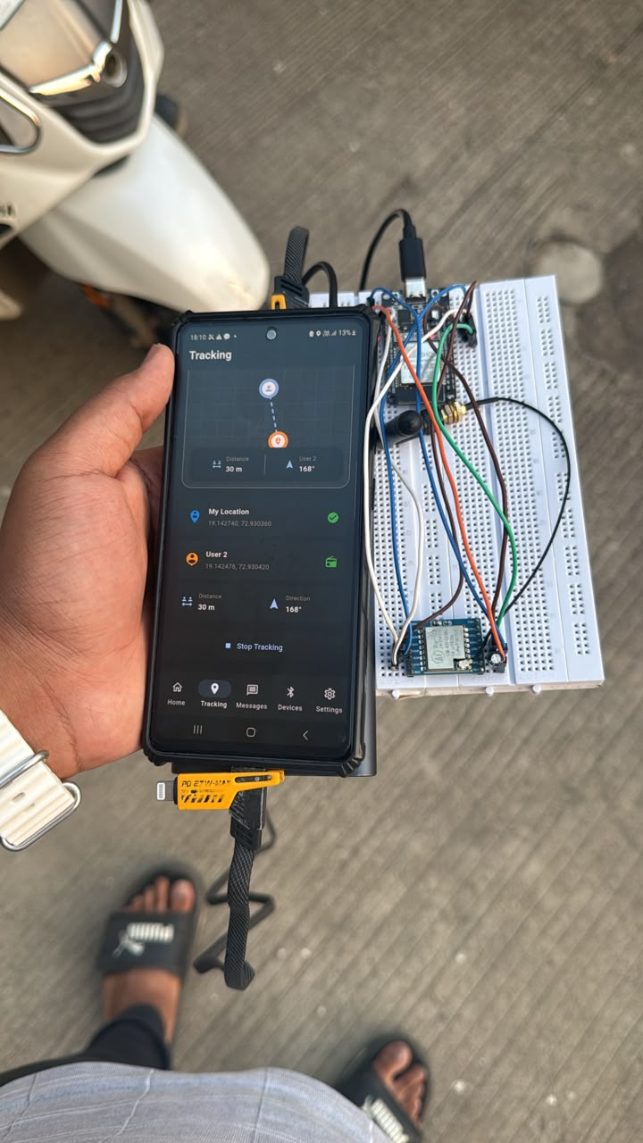
Results and Discussion
Serial communication test
Prototype
Tracking screen
BLE connection and bidirectional LoRa packet exchange are established.
The app receives peer location data; serial testing exposes RSSI and SNR.
An initial field run reached about 500 m on a partly obstructed route; range depends on antenna placement and local conditions
Concrete/buildings can weaken radio reception and reduce phone GPS quality. Wider field testing is still needed.
13

Slide 15
Conclusion
The prototype combines smartphone GPS, a Flutter Android application, BLE, ESP32 and SX1278 LoRa radios to exchange location information between two users. The application and radio link have been integrated, and both nodes can send and receive location packets. Initial tests also show RSSI and SNR readings and demonstrate operation without a cellular or internet connection on the core LoRa path. Results vary with antenna position, terrain and obstructions, so the system needs wider field testing before its range and accuracy can be characterized.
The current design is a working prototype for general outdoor location sharing.
14

Slide 16
Future Scope
Measure range, packet delivery, delay, RSSI and SNR across repeatable LOS and NLOS routes.
Compare phone GPS coordinates with known reference points in open and obstructed areas.
Improve antenna mounting, enclosure and node power management.
Add optional SOS messages and evaluate relay or mesh nodes for wider coverage.
Refine the app’s location display and testing logs.
15

Slide 17
Applications
Potential uses for the current two-user design and future multi-node versions
Trekking and hiking groups
Outdoor events and campus activities
Remote field teams in agriculture, forestry
Disaster response and search teams where network coverage is limited
Rural or isolated work sites
16

Slide 18
References
https://doi.org/10.11591/ijece.v11i4.pp3123-3128
https://doi.org/10.18280/ijsse.140610
https://www.mokosmart.com/what-is-a-lora-module/
https://ieeexplore.ieee.org/document/10911982
https://www.researchgate.net/publication/389765045_A_LoRa-Based_Communication_System_for_Real-Time_Location_Tracking_and_Emergency_Signaling_in_Military_Simulation_Exercises
https://ieeexplore.ieee.org/document/11398157
https://ieeexplore.ieee.org/document/11398157
17
Notes:
References 1 and 2 were checked against the cited publication records. The remaining URLs were retained from the supplied project deck.

Slide 19
Thank You
Questions and Discussion
LoRa-Based Real-Time Tracking and Communication System

